Slide 1
Trauma, Violence and ACEs: Promoting Resilience
in Our Children
The Urban Child Institute Watercooler Series
Altha J. Stewart, MD
University of Tennessee Health Science Center
Director, Center for Health in Justice Involved Youth
March 7, 2016

Slide 2
Agenda
Trauma
Childhood exposure to violence
Adverse childhood experiences
What we can do

Slide 3
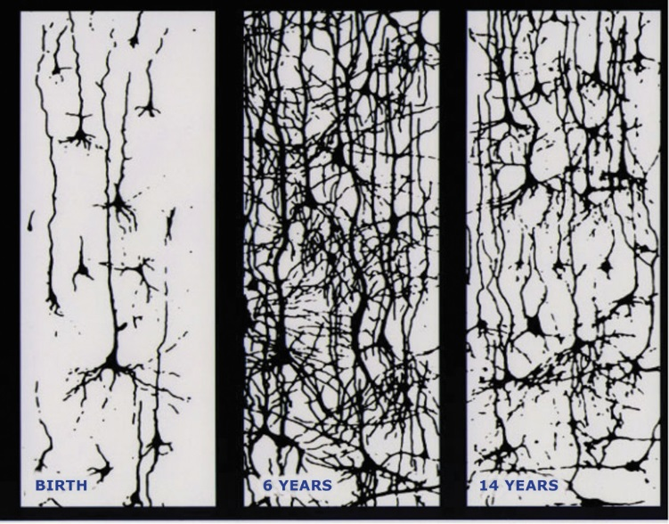

Slide 4
Know the numbers!
700 new neural connections per second
18 months: age when disparities in vocabulary appear
90-100% chance of developmental delays when children experience 6-7 risk factors
3:1 odds of adult heart disease after 7-8 ACEs
$4-$9 ROI for every dollar invested in early childhood

Slide 5
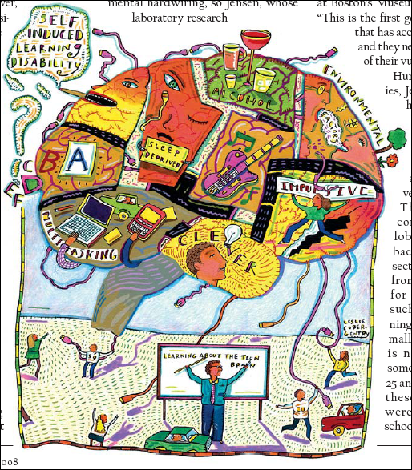
“It would be nice if it were that simple”

Slide 6
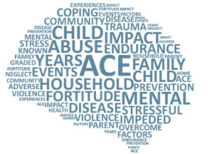

Slide 7
Children and Traumatic Events
Over half the children in the US are exposed to violence, crime and abuse every year
26% will witness or experience a traumatic event before the age of 4
Exposure to violence in any form harms children and can have many negative effects throughout childhood and into adulthood.
We spend over $100 billion on problems related childhood abuse and trauma (physical, emotional, legal, etc.)

Slide 8
Trauma Facts
Being abused or neglected as a child increases the likelihood of arrest as a juvenile by 59% (Widom, CS, 1995).
70% - 92% of incarcerated girls reported sexual, physical, or severe emotional abuse in childhood (DOC, 1998; Chesney & Shelden, 1992).

Slide 9
Trauma Facts
Trauma does not automatically cause PTSD (25% risk), violation/degradation/betrayal increases risk to 50-75+%
Trauma is Epidemic in 60% of Adults and 50% of Children
Trauma is almost universal for boys (93%) and girls (87%) in the JJ System
Trauma increases the risk of further trauma (most survivors have at least 2 distinct trauma incidents).

Slide 10
Trauma
By adolescence, children have sufficient skill and independence to seek relief through the following:
Drinking alcohol
Smoking tobacco
Sexual promiscuity
Using psychoactive materials
Overeating/eating disorders
Delinquent behavior

Slide 12
Traumatized Children
World is punitive, judgmental, humiliating and blaming
Control is external, not internalized
People are unpredictable and untrustworthy
Defend themselves above all else
Believe that admitting mistakes is worse than telling truth

Slide 13
CHILDHOOD EXPOSURE TO VIOLENCE

Slide 15
“Scientific research on the causes of children’s exposure to community violence and ways to prevent and treat its adverse effects requires a coordinated national initiative to develop public-private partnerships and funding in order to ensure that the most effective and efficient interventions are available to, and used successfully in, every community in our country.”
Former Attorney General Eric Holder

Slide 16
Adverse Childhood Experiences
(ACEs)

Slide 17
Findings
ACEs are surprisingly common
ACEs still have profound effect 50 years later
Transformed from psychosocial experience into physical diseases, social dysfunction and mental illness
ACEs are the main determinant of the health and
social well-being of the nation.

Slide 18
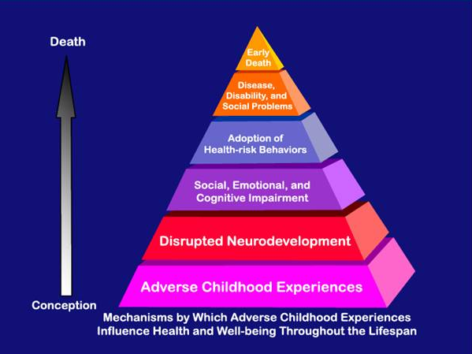
ACE influences on healthy development

Slide 19
ACEs shows us that adults who experienced multiple adverse experiences in their youth have increased risk for poor health outcomes such as obesity, alcoholism, and depression.
We know less about the relationship between adverse experiences and well-being in childhood or adolescence.

Slide 20
Adverse Childhood Experiences (ACE) Questionnaire

Slide 21
While you were you were growing up, during your first 18 years of life:
1. Did a parent or other adult in the household often or very often… Swear at you, insult you, put you down, or humiliate you?
or
Act in a way that made you afraid that you might be physically hurt?
Yes No If yes enter 1 ________
2. Did a parent or other adult in the household often or very often… Push, grab, slap, or throw something at you?
or
Ever hit you so hard that you had marks or were injured?
Yes No If yes enter 1 _______
3. Did an adult or person at least 5 years older than you ever…
Touch or fondle you or have you touch their body in a sexual way?
or
Attempt or actually have oral, anal, or vaginal intercourse with you?
Yes No If yes enter 1 ________

Slide 22
ACE Questionnaire (cont’d)
4. Did you often or very often feel that …
No one in your family loved you or thought you were important or special?
or
Your family didn’t look out for each other, feel close to each other, or support each other?
Yes No If yes enter 1 _________
5. Did you often or very often feel that …
You didn’t have enough to eat, had to wear dirty clothes, and had no one to protect you?
or
Your parents were too drunk or high to take care of you or take you to the doctor if you needed it?
Yes No If yes enter 1 ________
6. Were your parents ever separated or divorced?
Yes No If yes enter 1 ________

Slide 23
ACE Questionnaire (cont’d)
7. Was your mother or stepmother:
Often or very often pushed, grabbed, slapped, or had something thrown at her?
or
Sometimes, often, or very often kicked, bitten, hit with a fist, or hit with something hard?
or
Ever repeatedly hit at least a few minutes or threatened with a gun or knife?
Yes No If yes enter 1 ________
8. Did you live with anyone who was a problem drinker or alcoholic or who used street drugs?
Yes No If yes enter 1 _________

Slide 24
ACE Questionnaire (cont’d)
9. Was a household member depressed or mentally ill, or did a household member attempt suicide? Yes No If yes enter 1 __________
10. Did a household member go to prison?
Yes No If yes enter 1 _________
Now add up your “Yes” answers: _____________ This is your ACE Score.

Slide 25
EXPANDED ACEs
Not included in the original ACE Study, these areas were examined as additional correlates of children's distress:
Parents always arguing
Someone close to the child had a bad accident or illness
Exposure to community violence
No good friends
Below-average grades
Removed from family
Very overweight
Physical disability
Neighborhood violence is a “big problem”
Homelessness
Repeated a grade

Slide 26
Adverse Childhood Experiences (ACE)
Changes The Conversation
from
“What’s Wrong With You”
to
“What’s Happened To You”

Slide 27
Prevalence of indicators of negative well-being, by number of adverse childhood experience (12-17)
Measure of well being | 0 ACEs | 1 ACEs | 2 ACEs | 3+ ACEs
High externalizing behavior | 18% | 26% | 33% | 41%
Low engagement in school | 25% | 33% | 44% | 48%
Household contacted due to problems at school | 13% | 23% | 31% | 38%
Grade repetition | 6% | 12% | 14% | 21%
Does not stay calm and controlled | 24% | 34% | 40% | 44%
Does not finish tasks started | 27% | 36% | 44% | 49%
Diagnosed with a learning disability | 9% | 13% | 16% | 23%
Fair or poor physical health | 2% | 4% | 4% | 6%

Slide 28
“It’s about the right to have a present and a future that are not completely dominated and dictated by the past.”
Karen Saakvitne

Slide 29
What can WE do?

Slide 30
“Risk factors are not
predictive factors due to protective factors”

Slide 31
Remove barriers to service access
Identify barriers and challenges upfront with the community (before deciding on the services)
Provide services to deal with depression, anxiety, trauma, PTSD, domestic violence, substance dependence, and other conditions that get in the way of creating an environment of positive relationships that a child needs from the beginning and throughout the developmental life-span
Consider location, capacity, cultural alignment, community assessed needs and community involvement strategies

Slide 32
Create Trauma Informed SYSTEMS OF Care
Understand the prevalence and impact of trauma
Promote safety
Communicate with compassion
Earn trust
Embrace diversity
Provide holistic care
Respect human rights
Pursue the person’s strengths, choice and autonomy
Share power

Slide 33
TIC - Impact on Child Development
The ability to form healthy relationships is highly dependent on learned social skills
Children’s social skill learning is directly related to the characteristics of their environments
Violence teaches withdrawal, anxiety, distrust, over-reaction and/or aggression as coping behaviors
Disordered environments=dysfunctional skills

Slide 34
System of Care
Strengths-based approach that incorporates natural supports (“the village”), services (“treatment, support, advocacy”), and skills building related to self-advocacy, education and empowerment
Creates family centered, youth focused services and supports that includes schools and other child-serving agencies
Utilizes a ‘wraparound’ approach to working with children and their families
Works from a “needs” base, not a problem (“deficit”) focus with clear and measureable goals

Slide 35
Protective Factors
Strengths-based approach to supporting children that incorporates natural supports (“the village”), services (“treatment, support, advocacy”), and skills building related to self-advocacy, education and empowerment
Create family centered, youth focused services and supports
Utilize a ‘wraparound’ approach to working with children and their families
Work from a “needs” base, not a problem (“deficit”) focus

Slide 36
Think Sustain!
Cultivate strong interagency and community relationships
Create opportunities to maximize resources
Combat stigma and build capacity in the community

Slide 37
“We know from the lessons of SOC that sustainability is dependent on the ability to articulate and then operationalize a core set of values, create structures and processes for effective collaboration across various and divergent partners, and establish effective mechanisms to collect and use information for decision making and continuous quality improvement.”

Slide 38
Why C.R.A.P.P. is Important
(Community’s Recognition and Awareness of Potential Potholes)

Slide 39
Because……
Change makes people uncomfortable, status quo is so much easier…
There are at least 10 reasons why a partner behaves the way they do! (i.e., says yes, behaves like no) - Karl Dennis-“collaboration is an unnatural act between unconsenting adults”
“the CRAPP may be you” - avoid getting lulled into the “it’s not me, its them” blame game; if they would just do what I say
Everyone has a different definition of ‘community’ – project, families, partners, and the ‘community’
Work with families from the start. They may never fully trust you but many of them rely on us and need to be armed with information. Use the family support model if it’s available.

Slide 40
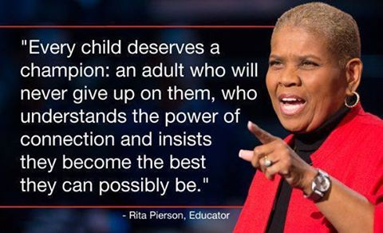

Slide 41
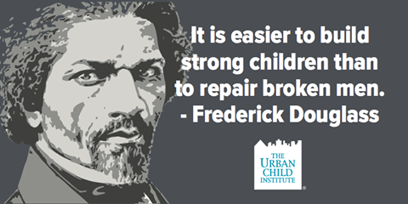

Slide 42
Altha J. Stewart, M.D.
901-448-3028 – o
astewa59@uthsc.edu

