Slide 1
Brain Awareness Night!
“Literacy and Language Development in the Early Years”
The Urban Child Institute
March 12, 2015
J. Helen Perkins, Ed.D.
Associate Professor of Reading & Urban Literacy
Instruction & Curriculum Leadership
The University of Memphis

Slide 2
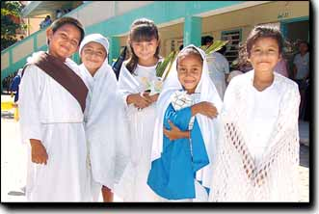
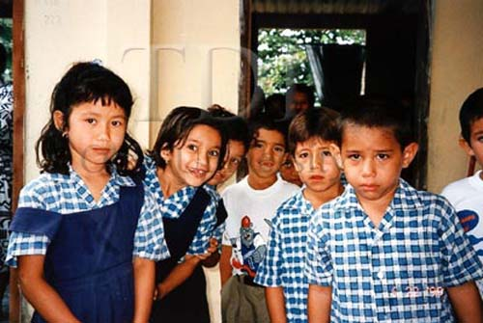
Choral Read! “Without question, education is the key to progress and prosperity in the United States today. Whether fair or not, educational opportunity and academic achievement are directly tied to the social divisions associated with race, ethnicity, gender, first language, and social class. The level and quality of educational attainment either opens the doors to opportunity or closes them.” Edmund W. Gordon

Slide 3
The Importance of Oral Language
Children arrive in Kindergarten with huge discrepancies in oral language development…and the gap between language-advanced and language-delayed children grows throughout the elementary school years.
Biemiller (2001)

Slide 4
RESEARCH
The current wave of research emphasizes the long-recognized connection between oral language and future reading and writing.
Solid oral language skills are crucial for visual comprehension (making a picture in the mind), for conceptual knowledge and for vocabulary development.
Oral language practiced with supportive adults contributes to reading success.
BOOK LANGUAGE
The Hart and Risley study (2003) indicated that by age 3, children of professional parents had vocabularies of about 525 words, whereas children in homes considered economically deprived had vocabularies of 117 words.
Families who spoke more words to children made the difference; the use of complex language stimulated cognitive growth!

Slide 5
Language Development
Reading and being read to increases vocabulary learning. Books provide challenging ideas, colorful descriptive words and concepts, and new knowledge and information about the world in which we live.
-Burns et. Al (1999)

Slide 6
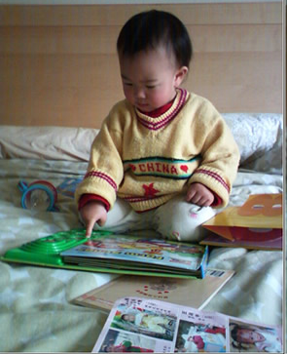
Infants and Toddlers
• Read: Read to infants for at least 30 minutes a day. Read stories or poems. While reading, position your mouth or face where the infant can see it. While reading to toddlers, encourage them to turn the pages.
• Talk: Talk to infants about what you are doing. Talk about changing the diaper, washing hands, and putting on shoes, for example. Use short and simple sentences.
• Name surrounding objects: Pronounce the names of objects that surround the baby such as bottle, diapers, and table. The baby will begin to connect the sound of the word to the object.
• Look and listen: Talk about what you see and hear. When a baby drops a spoon, for example, say, “Did you hear that? Your spoon hit the floor.”
• Give simple directions: Give a toddler simple directions and recognition for completing the task. “Please go and get your cap.” “Yes! You got your cap. Now you can put it on your head.”
• Provide toys: Have stuffed animals, puppets, and other toys available for children because playing with them will encourage children to talk.

Slide 7
Engaging Activities!
Play “Follow the Leader”: Encourage children to follow you around the room and name each object you touch.
• Talk about family pictures: Encourage children to talk about it.
• Ask open-ended questions: Frame questions so they require the child to answer with several words, not yes or no. Ask questions such as “If you wanted to have more fun in this play yard, how would you change it?” and “What did you do at your grandmother’s house yesterday?” Be sure to listen while the child talks.
A rule of thumb is to begin questions with “wh” words: Questions that begin with who, what, where, when, and why (and how) encourage children to talk and to begin to explain their answers. They will use more words. Sometimes they will use words they didn’t know were in their vocabulary.

Slide 8
TALK and LISTEN!
While Changing Diapers
While Walking to the Play Area
While in the Play Area
While Getting Ready for Home
Encourage the Children to Talk
Identify Every Food Item
Talk about Pictures
Praise the Child
Expand the Child’s Sentence by adding a few Words to Their Sentence.

Slide 9
Talking Leads to Learning
Oral vocabulary refers to words children recognize in speaking or listening (National Reading Panel, 2000).
Children must have a receptive (listening) and expressive (talking) use of oral language so they can become successful readers (Clay, 1979).
Children learn the meanings of most words indirectly; meaningful talk is powerful (CIERA, 2001).
Children between the ages of 2 and 6 learn an average of 6 to 10 new words a day (Reutzel and Cooter, 2000).
When 4- to 5-year-old children hear a single book reading, their expressive vocabulary significantly improves (Senechal and Cornell, 1993).

Slide 10
Talking Leads to Learning
Reading the same story several times allows children to hear adults repeat new words and to review words they find intriguing.
The size of children’s spoken vocabulary is important. (In hearing Little Bear’s Friend, for example, 4-year-old Jacob might recall how he made a new friend on vacation.)
The more children’s oral language mirrors the written language they encounter, the more successful they will likely be in reading (National Reading Panel, 2000; Bridge, 1978).
When texts relate to oral language experiences, children quickly discover that written and oral language are parallel forms of language that serve similar purposes for communication (Reutzel and Cooter, 2000).

Slide 11
Use Books to Stimulate Oral Language
• Always have available a variety of books.
• Choose high-quality books about topics such as animals, places, and things that children like.
• Choose books that positively reflect children’s identity, home language, and culture.
• Discuss the story before, during, and after reading.
• Discuss the title and what might happen in the story. Encouraging the children to make predictions stretches their thinking and imagination.
• Point to the pictures and talk about them.
• Help children relate words to their prior knowledge and experiences such as taking a bath, eating, or playing outdoors.
• Read in a natural way, as if you were talking. Use expression by changing your voice tone with each character. Use hand and body gestures.
• Pause to explain unfamiliar words.
• Encourage parents to take advantage of times in the doctor’s waiting room and at the Laundromat by talking and reading to the children.

Slide 12
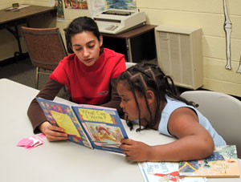
Pause & Reflect!
How can we give all children the opportunity to become
truly free?
Literacy is the door to social justice – it is a sacred
task. The parent, caregiver, tutor & reading teacher must be an If – Then Thinker and problem solver – he/she cannot be on the sidelines. It is an active and ever changing task.

Slide 13
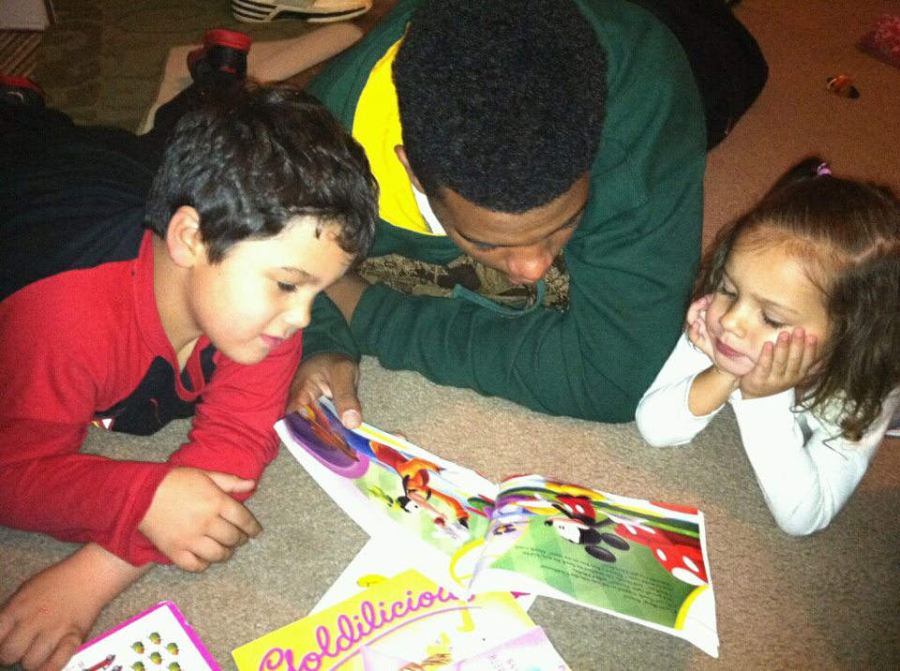
Reading Aloud
Reading to a child is a critical factor in the child becoming a successful reader.
Research confirms that reading aloud to children positively impacts overall academic achievement.
--From Conversations (2000), Regie Routman, pp. 29-30.

Slide 14
Reading Aloud to Promote and Enhance Language Development
Activates Prior Knowledge
Adds new information to an incomplete schema (slot filling)
Relates to story-specific information
Builds and extends concepts
Reflects “Reading to Learn”
Developing a “Sense of Story”
Using the Elements of Story Structure and Conventions
*Plot- Problem/Goal/Events
*Setting
*Character
*Theme
*Point of View
Understanding Book/Literacy Language
Developing Oral Language
Builds a Rich Vocabulary

Slide 15
Creating Meaningful Contexts for Learners to Promote Language Development
Visuals
Objects
Diagrams
Labels
Simulations
Gestures
Dramatizations with Specific Tasks
Modeling with Specific Tasks
Role Play with Specific Tasks

Slide 16
A Sampling of Pre-reading Skills
• Understands the function of a book.
• Recognizes that print represents spoken language.
• Recognizes that words represent names of people and things.
• Distinguishes letters from words.
• Recognizes that words are separated by spaces.
• Follows words left to right and from top to bottom.
• Understands that the sequence of letters in a written word represent the sequence of sounds (phonemes) in a spoken word (alphabetic principle).
• Demonstrates phonemic awareness by rhyming, clapping syllables, and substituting sounds.
• Matches sounds to alphabetic letters.
• Recognizes and names most uppercase and lowercase letters of the alphabet.
• Uses picture clues to aid understanding of story content.
Notes:
Concepts About Print

Slide 17
Engaging Activities
Provide props: Place props in the dramatic play center or use at circle time. A dentist kit, for example, may encourage children to talk about their experiences in going to the dentist.
• Discuss art work: Encourage children to discuss their creations: “Tell me about your painting.” “How did you feel while making this collage?”
• Talk while playing: Encourage children to talk while playing in the block building and dramatic play centers; these activities are interactive and collaborative. While children are playing and talking, their vocabulary will improve because they hear themselves and remember some of the words they have heard adults use.
• Play “Objects in a Bag”: Place a few items such as a cap, plastic cup, and spoon into a bag. Have the child pull an object from the bag and talk about it. The child can describe the object and talk about how it’s used.
• Record sounds in nature: Tape record sounds from outdoors. While playing sounds such as birds, moving vehicles, and dogs barking, encourage children to talk about what they hear. Encourage children to write about or draw pictures representing the sounds they hear.
• Read or tell a story everyday: Vary the reading format, using books as well as flannel board and puppets, for example. Have a well-stocked book center that children can use on their own.

Slide 18
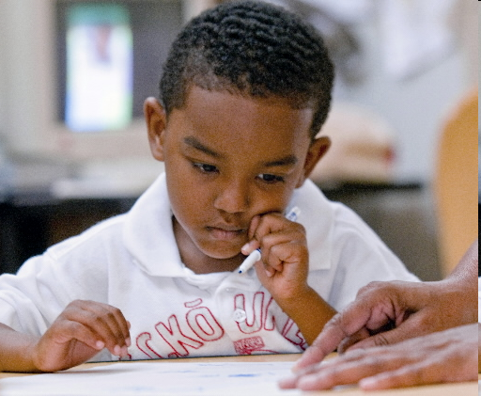
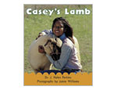
Engaging Activities
Write notes: Write the child a note, such as “Wow! You caught the ball three times today.” Read the note to the child in an expressive way, PROSODY!
Loan books from your library: Set up a book lending program so children can take books home to read with their families. Oral language activities lay the foundation for future literacy learning. By providing a rich oral-language environment
Solve a puzzle: While working with a child to solve a puzzle, talk about the pieces, colors, and shapes. Encourage conversation.
• Take field trips: Expose children to a variety of experiences by visiting the zoo, library, park, and museum. Encourage children to make comments and to ask questions. Encourage children to tell their families about their trip.
• Read or tell a story every day.

Slide 19
Reflective Practitioner Maximizing Cognitive Engagement
Academic Engaged Time: The time when children are actually attending and doing the activities at hand.
ENGAGEMENT IS KEY!
ENGAGEMENT IS KEY!

Slide 20
Maximizing Cognitive Engagement
Provide Clear Instructions
Model procedures to ensure children understand
Keep up an active pace to maintain attention
Motivation
Journals- Child Draws/Scribbles- You Scribe
Prosody!
Language Constantly – Vocabulary
Use Color- The Brain Loves Color
Select Appropriate Materials
Match & Sort Things that are Alike & Unalike
Make Connections- Background-Schema

Slide 21
Pause & Reflect!
ADAPTATIONS…
If a child can’t
learn the way we teach,
we will teach
the way he/she learns…

Slide 22
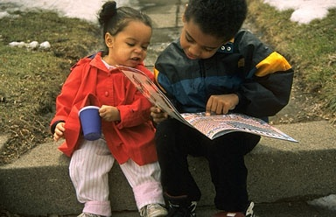
As members of the community, we must take responsibility for educating all our children –whether ours by birth or otherwise-to uplift our people as a whole.
E. W. Gordon

Slide 23
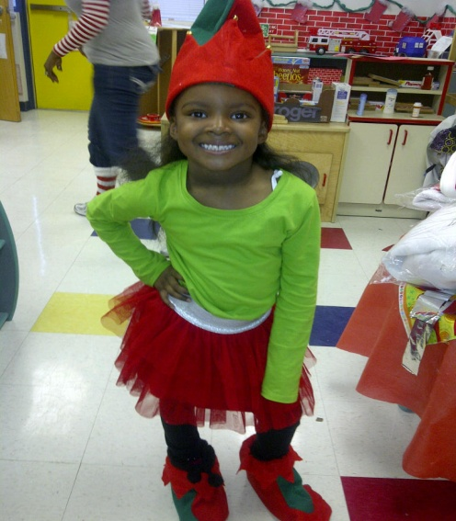
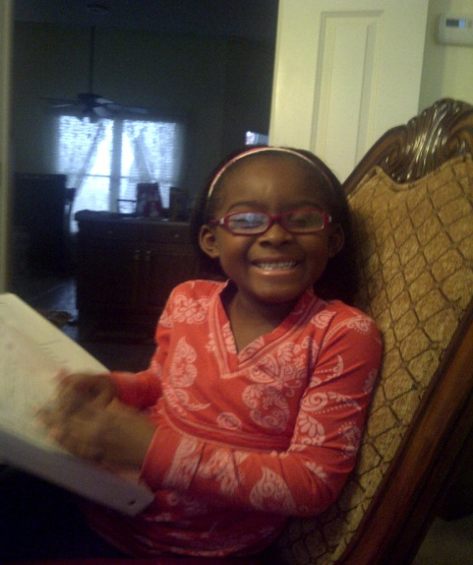
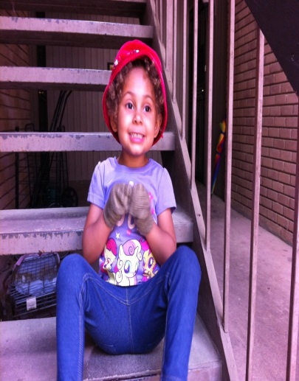
Thank YOU for Making a Difference in the Lives of OUR CHILDREN!
YOU ARE APPRECIATED!

